Slide 1
DRC
KINSHASHA

Slide 2
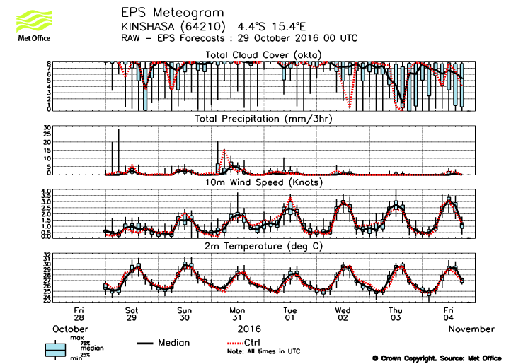
EPS UKMET

Slide 3
DETAILED FORECAST SUNDAY 30
CLOUDINESS: MEDIUM PROBABILITY MOSTLY CLOUDY
PRECIPITATION: HIGH PROBABILITY OF RAIN LESS THAN 5MM IN 3HRS AROUND 12UTC
WIND: MEDIUM PROBABILITY OF 2 KNOTS
TEMPERATURE: HIGH PROBABILITY OF MINIMUM REACHING 25.0’C AND MAXIMUM REACHING 30.0’C

Slide 4
DETAILED FORECAST MONDAY 31
CLOUDINESS: HIGH PROBABILITY OF CLOUDINESS
PRECIPITATION: HIGH PROBABILITY OF RAIN. WITH A LOW PROBABILITY OF RAIN REACHING 15-20MM BETWEEN 03 AND 06UTC.
WIND: HIGH PROBABILITY OF 2 KNOTS
TEMPERATURE: HIGH PROBABILITY OF MINIMUM REACHING 26’C AND MAXIMUM REACHING 28’C

Slide 5
DETAILED FORECAST TUESDAY 01
CLOUDINESS: HIGH PROBABILITY OF CLOUDINESS WITH LOW PROBABILITY OF CLEAR PERIODS IN THE AFTERNOON AROUND 12UTC.
PRECIPITATION: HIGH PROBABILITY OF LITTLE RAIN. WITH A LOW PROBABILITY OF RAIN REACHING 10MM AT 12UTC.
WIND: MEDIUM PROBABILITY OF 2-3 KNOTS
TEMPERATURE: HIGH PROBABILITY OF MINIMUM REACHING 25’C AND MAXIMUM REACHING 29’C

